Slide 1
Alkalmazásfejlesztés
279525368
Nagyvállalati rendszerek fejlesztése és üzemeltetése DevOps alapokon | Major Balázs | 2026/02/16

Slide 2

Introduction - Balázs Major
Application Developer for 20 years
Focus on backend development
Nowadays practice in cloud-ready application
Stream Leader in Magyar Telekom
Developer in a developer team
www.linkedin.com/in/majorbalazs

Slide 3
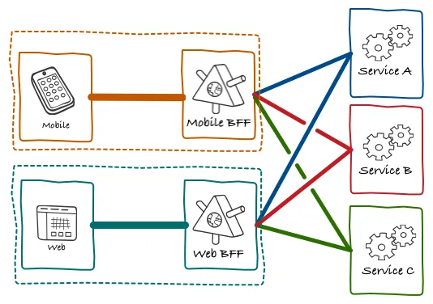
The development architecture
Front end: Mobile applications, Web applications, TV platform, etc.
Back end: Microservice based architecture
Technology: Spring based (Java), NestJS, GoFr services
Language: Kotlin, NodeJS, Go
Domain: Product, Consumer, OSS

Slide 4
Agenda
Software development
Refinement
Implementation
Testing & Integration
Task & Demo

Slide 5
Software development

Slide 6
The Software Development Lifecycle
Design
DevOps team connect into the Software Development Cycle in Design phase.
Low level design
Refinement
Implementation
Agile sprints
Review
Refinement
Testing & Integration
Testing levels

Slide 7
Design

Slide 8

Application design
Development team is responsible for finding the fit of new business requirements.
The well design tasks are essential for the daily work of the development team.
Refinement is the next step after successful application design phase.

Slide 9

Definition Of Ready (DOR)
Product Backlog items that can be Done by the Scrum Team within one Sprint are deemed ready for selection in a Sprint Planning event. They usually acquire this degree of transparency after refining activities.
Acceptance Criteria
Title and brief business description
Acceptance criteria
Non-functional and security requirements
High Level Design

Slide 10
Implementation

Slide 11
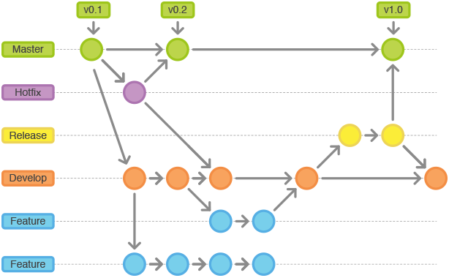
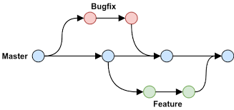
Branching strategy
GIT Flow
GitHub Flow
The selected branching strategy depends on the environments in use, the level of testing, and shared understanding.

Slide 12

Software Quality
Goals
Clean code
Quality of code
Readability of code
Makes code maintenance easier
Tools
Static code analyzer – SonarQube
Code reviews & common principles
High test coverage

Slide 13
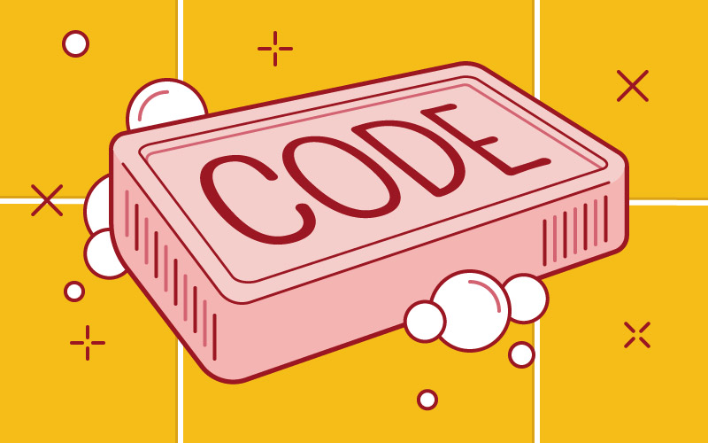
Clean code principles
Deep nesting – use functions instead
Comments – self-explanatory functions
Avoid large functions – separation
Code repetation
Meaningful names
Consistent verbs – get, set, create
Variables – camelCase
Classes – PascalCase
Constants – SNAKE_UPPER_CASE

Slide 14
Debugging & tools
Bug: Unexpected problem with any software
DeBug: Steps to isolate source of bug.
Tools: Logging, Chrome DevTools, IDE Debug tools – IntelliJ, Visual Studio Code

Slide 15
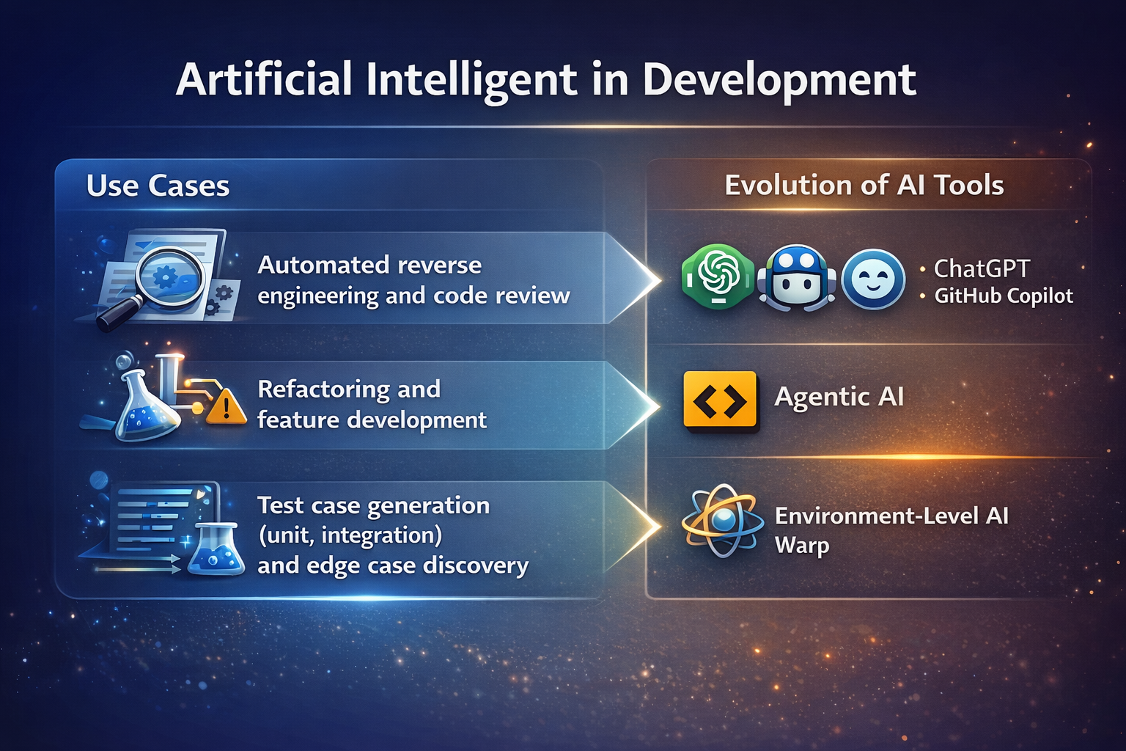
Artificial Intelligent in Development
Use Cases examples
Automated reverse engineering and code review
Refactoring and feature development
Test case generation (unit, integration) and edge case discovery
Evolution of AI Tools
Generative AI (ChatGPT, GitHub Copilot, Claude)
Agentic AI (Claude Code)
Environment-Level AI (Warp)

Slide 16
Testing and integration

Slide 17
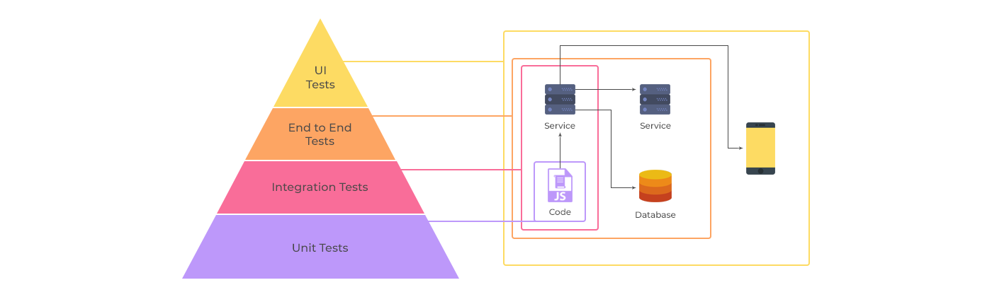
Testing pyramid
Unit Tests
Low level Integration Tests
Out of scope: End to End Tests, UI Tests

Slide 18
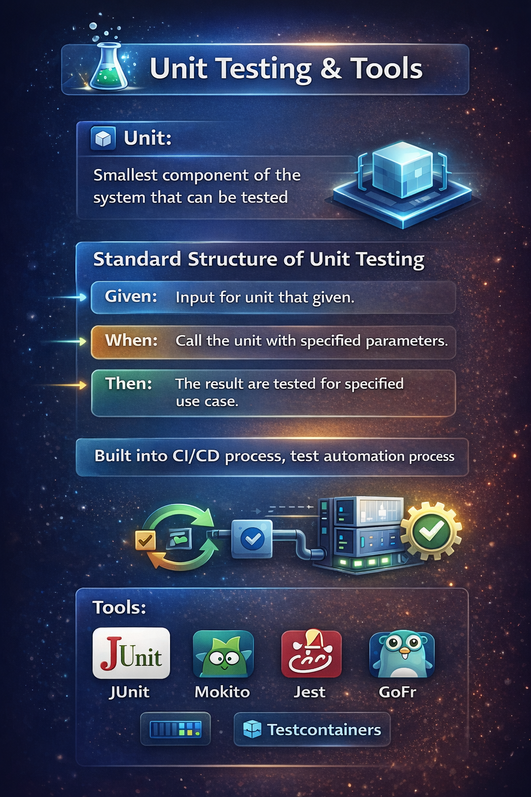
Unit testing & tools
Unit: smallest component of the system that can be tested
Standard structure of unit testing:
Given: Input for unit that given.
When: Call the unit with specified parameters.
Then: The result are tested for specified use case.
Built into CI/CD process, test automation process.
Tools: JUnit – Mockito, Jest, GoFr, Testcontainers

Slide 19
Low level Integration tests & tools
Testing service integration points with or without mocking.
Levels: component, integration test.
Can be run in CI/CD process.
Tools: Wiremock, Postman.

Slide 20

End-to-end test & tools
Complex test for business use cases.
Types:
UI test,
System test.
End-to-end tests are cannot be fit into CI/CD process.
Test automation process.
Tools:
UI Tests: Selenium,
Manual tests.

Slide 21
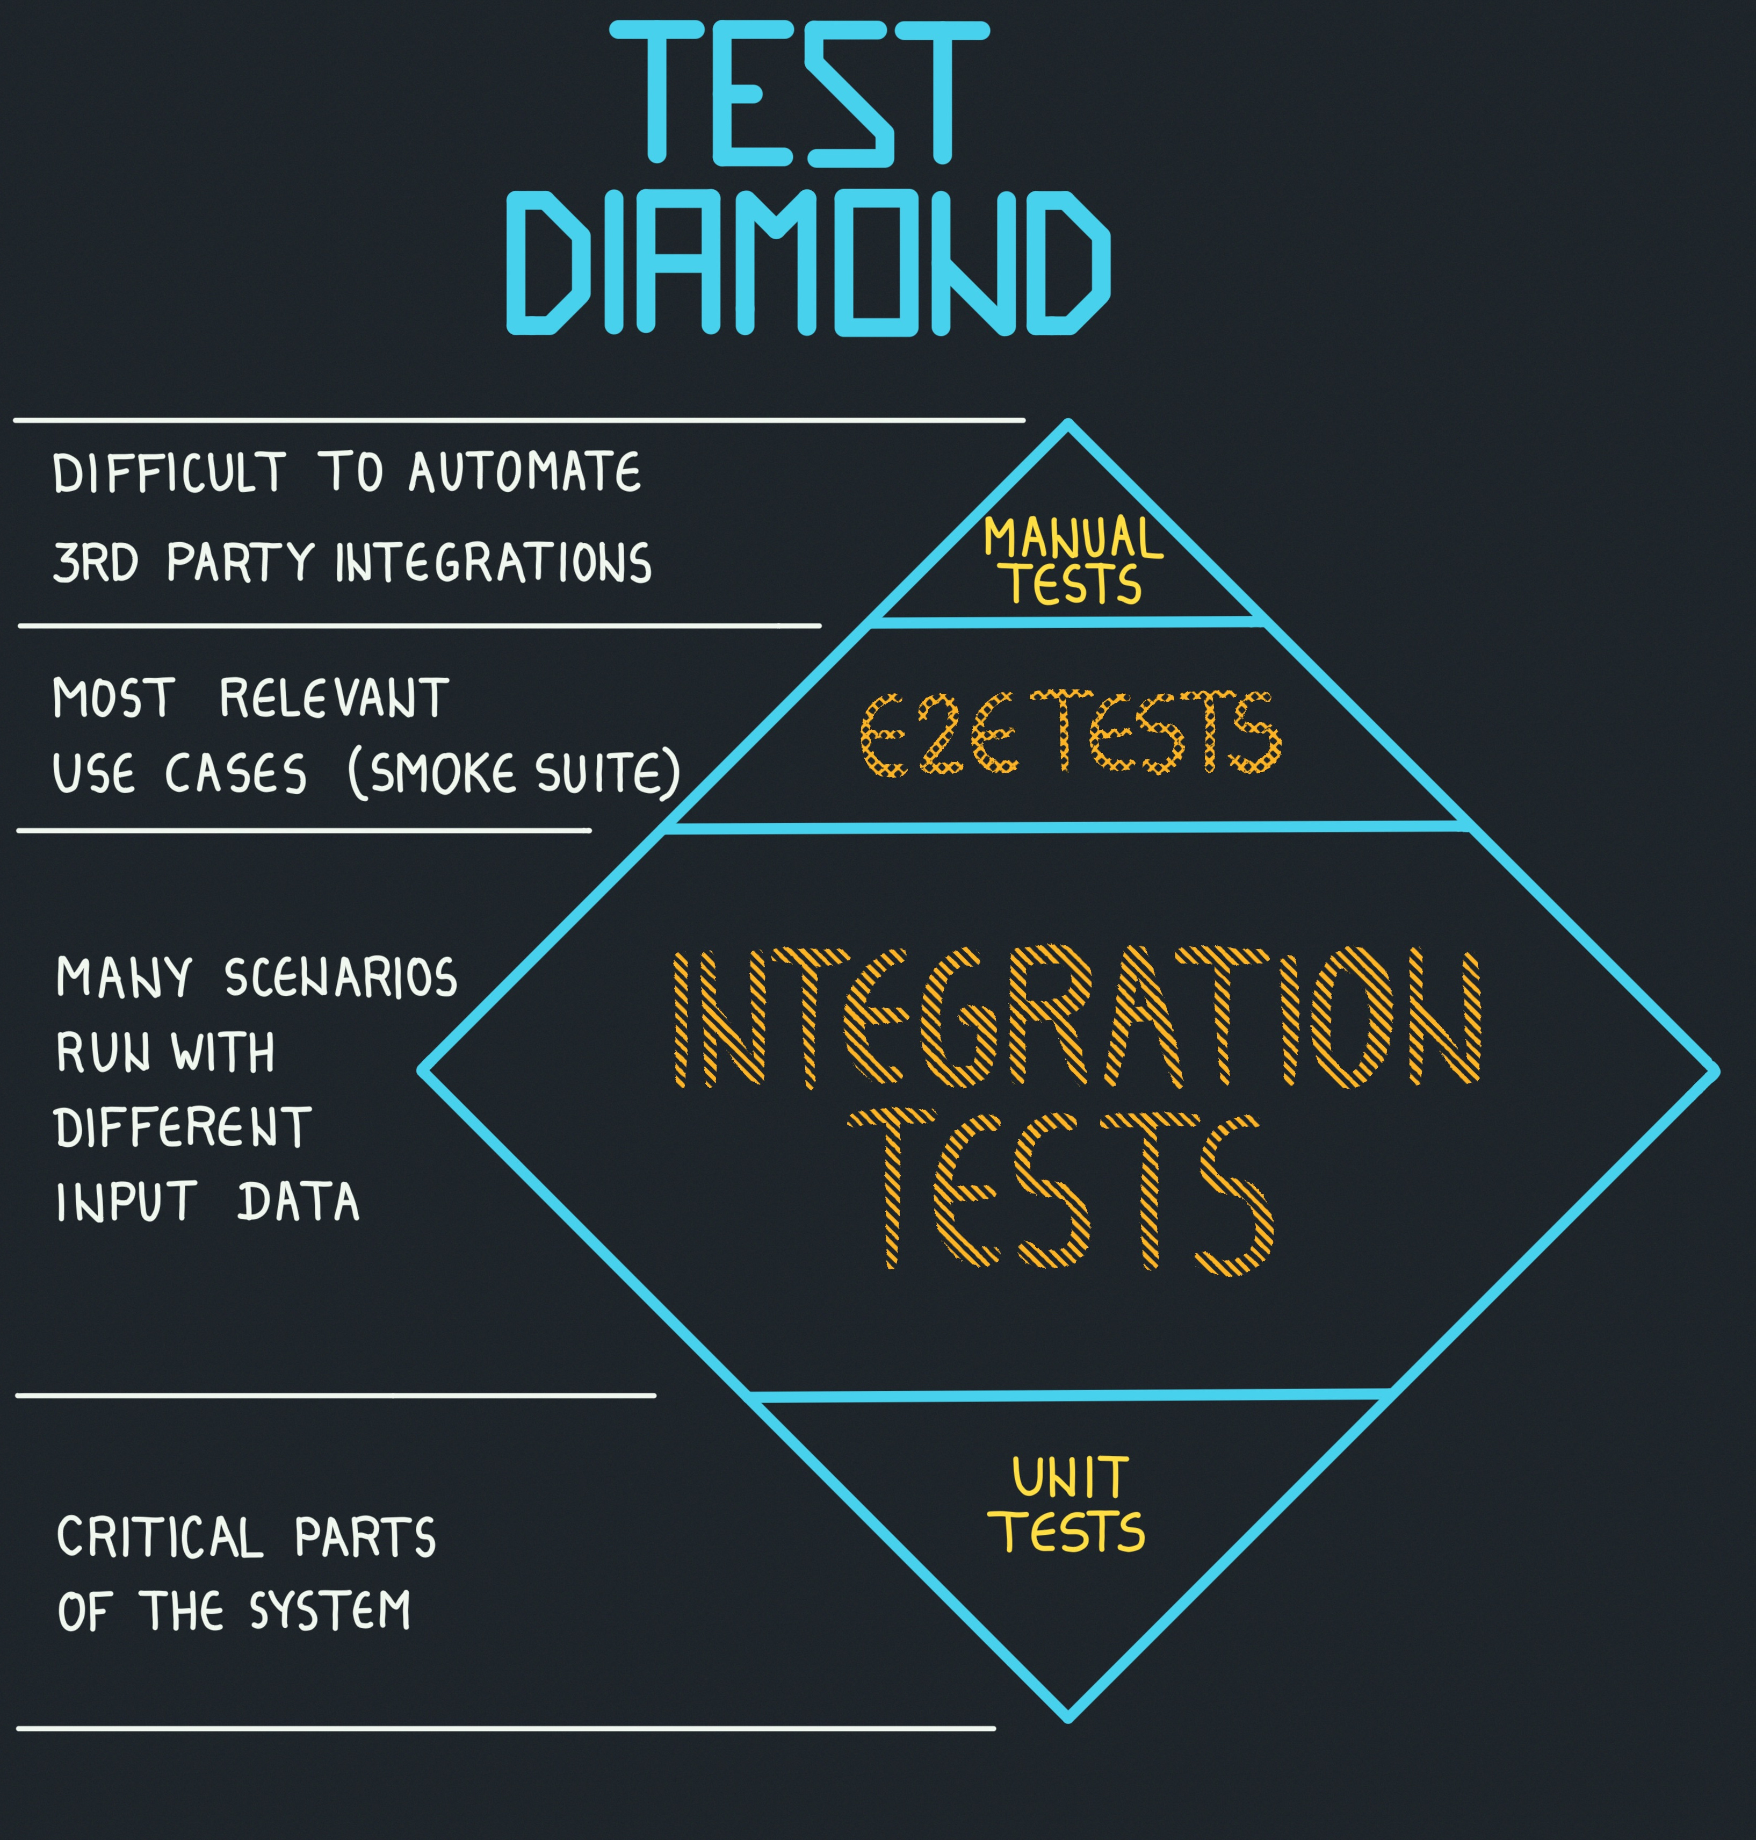
Testing diamond
New wave on microservice development: boundaries of application was changed
Focused into integrations tests on microservice based architectures
Advantages:
production like test cases,
less time is spent to mock,
can be run on CI like unit tests.
Disadvantages:
run slowly,
test size is bigger.

Slide 22
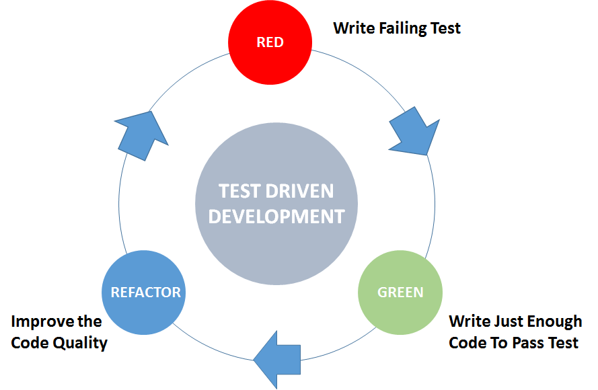
Test Driven Development (TDD)
Process
Testing first
Unit test + Low level integration test
Benefits
Higher software quality
Better code coverage
More understand how the application used
Disadvantages
Needed more time to introduce
Other mindset

Slide 23
CI/CD

Slide 24
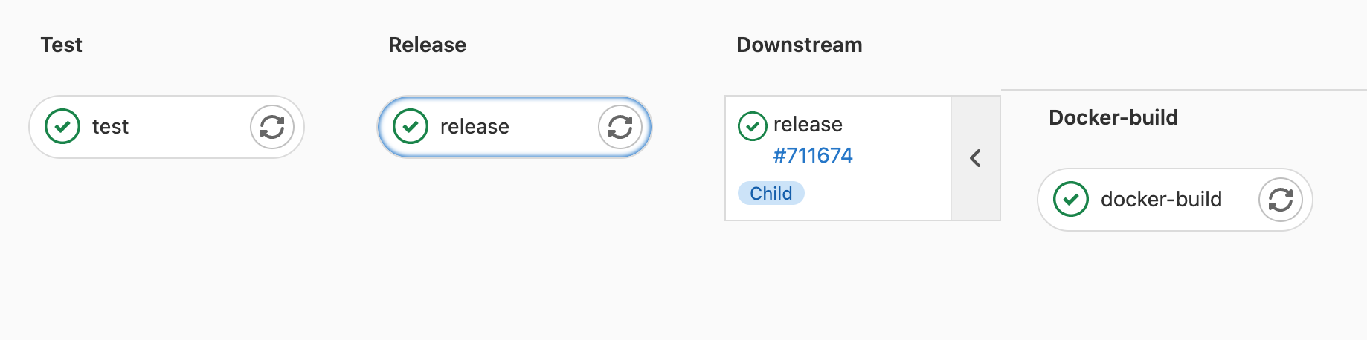
CI/CD - Part 1.
CI Stages
Test (style, static, coverage, semantic)
Release (semantic versioning)
Build (artifact, docker image)
public | Balázs Major | Alkalmazásfejlesztés

Slide 25
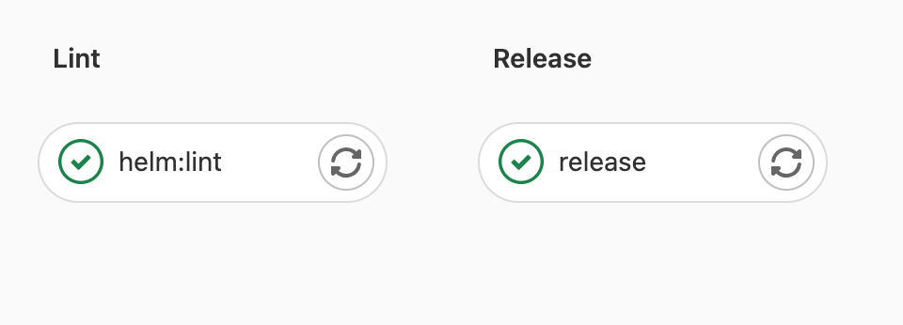
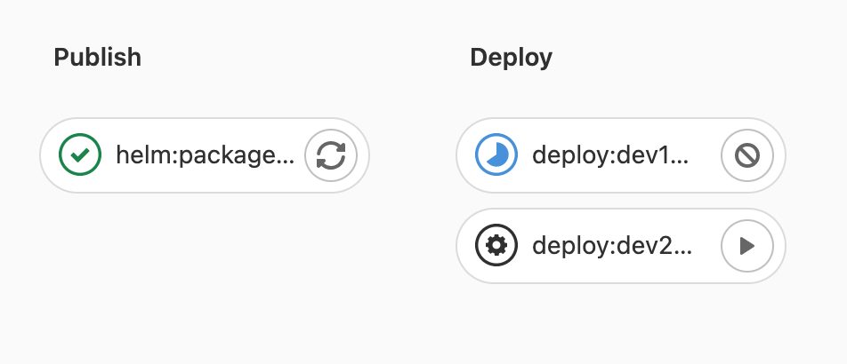
CI/CD - Part 2.
CD Stages
Lint (validate)
Release (semantic versioning)
Deploy (manual or automatic)
Test (manual or automatic)
public | Balázs Major | Alkalmazásfejlesztés

Slide 26
Task & Demo

Slide 27
Tasks
Create a GitHub account and repository by following the instructions below.
Follow the steps described to fork and develop a Spring application -> GitHub.
Use various tests to ensure correct implementation.
Try to solve the task using an Agentic AI, such as Claude Code.
Create a merge request for one of your colleagues or for me -> GitHub profile.

